Slide 1
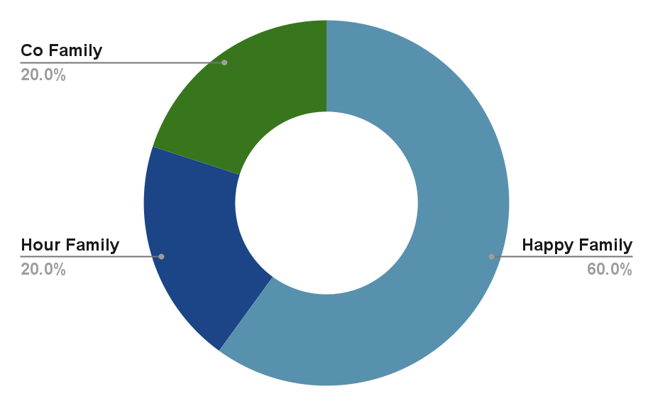
HappyHour Co. Company Profile
Leading producer of beer, spirits, and non-alcoholic beverages in Malaysia and Singapore
Overview
Key financials
Singapore based producer of beer, spirits and non-alcoholic beverages.
Markets in Singapore, Malaysia (Manufacturing outsourced to Brew Co) and China
Looking to expand into Cambodia
Majority owner wants to retire and exit the business
But wants to stay involved with the business and wants to maintain his ideologies
Key strengths
Developed strong supply side relations
Largest beer and spirits company in Singapore and Malaysia
Largest non-alcoholic beverage company in Malaysia
US$mm | FY18A | FY19A | FY20E
Revenue | 900 | 961 | 1071
Growth | - | 7% | 11%
Beer | 100 | 110 | 135
Spirits | 75 | 85 | 105
Non-Alcohol | 50 | 55 | 60
EBITDA | 225 | 250 | 300
Margin (%) | 25% | 26% | 28%
NPAT | 135 | 153 | 193
Margin (%) | 15% | 16% | 18%
Shareholders
Indicative valuation
US$mm
2020E |  |  | 300
Growth (%) |  |  | 20%
EV/EBITDA Multiple |  |  | 10.0x - 11.5x
Valuation |  |  | 3,000 - 3,500
Source: Notes on HappyHour Co
1

Slide 2
Overview of auction process and key workstreams
 | Date | Event | Key workstreams
Round 1: Indicative Bid Phase | Mar 19, 2020 | Access to the Indicative Bid Documents | Valuation Initial valuation analysis based on the Indicative Bid Documents Financing Discuss financing discussions Approvals Collect and confirm the approvals
 | 9 am, Apr 9, 2020 to 5pm, Apr 13, 2020 (HKT) | Indicative Bid and Q&A Submission
 | 5pm May 13. 2020 (HKT) | Indicative Bid Due
Round 2: Final Bid Phase | Late May, 2020 | Start final bidding phase Release of Process Letter Two | Site visits and management presentations Organise site visits and presentations Due diligence Conduct due diligence based on the new information provided Q&A Submissions Valuations Finalize valuations based on the forecasts Financing Confirm the sources of financing Approvals Commence application for internal regulatory approval
 | Late July, 2020 | Final Bid
1

